Slide 1
Unit II SUPERVISED LEARNING: REGRESSION
INT234:PREDICTIVE ANALYTICS

Slide 2
Content of presentation
SUPERVISED LEARNING: REGRESSION
Statistics
Simple Linear Regression
Multiple Linear Regression
Polynomial Regression
Logistic Regression
Ordinary Least Squares Estimation
Correlations
Evaluate Model Performance
Mean Absolute Error (MAE),
Mean Squared Error (MSE),
R-squared (R²) Score,
Root Mean Squared Error (RMSE)

Slide 3
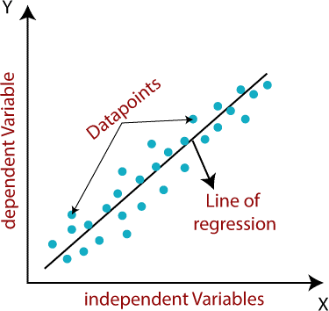
1. SUPERVISED LEARNING: REGRESSION
The goal is to predict continuous numerical values based on input data.
It’s called “supervised” because the model learns from labeled data
that is, data where both inputs and correct outputs are known.
Image source: https://www.meritshot.com/introduction-to-supervised-machine-learning/

Slide 4
1.1 SciPy package Introduction
SciPy is a scientific computation library that uses NumPy underneath.
SciPy stands for Scientific Python.
It provides more utility functions for optimization, stats and signal processing.
Like NumPy, SciPy is open source so we can use it freely.
SciPy was created by NumPy's creator Travis Olliphant.
pip install scipy
from scipy import constants

Slide 5
1.2 a little pinch of stats
Mean - The average value.
Median - The mid point value.
Mode - The most common value. [frequency]
speed = [99,86,87,88,111,86,103,87,94,78,77,85,86]
x = numpy.mean(speed)
x = numpy.median(speed)
from scipy import stats
x = stats.mode(speed)

Slide 6



1.3 Standard Deviation Sigma:
It is a number that describes how spread out the values are.
A low standard deviation means that most of the numbers are close to the mean (average) value.
A high standard deviation means that the values are spread out over a wider range.
Standard deviation is the square root of the variance.
import numpy
speed = [86,87,88,86,87,85,86]
x = numpy.std(speed)
print(x)
import numpy
speed = [32,111,138,28,59,77,97]
x = numpy.std(speed)
print(x)
Standard deviation
variance

Slide 7

1.4 Variance
Variance is another number that indicates how spread out the values are.
The average of the squared differences from the Mean.
To calculate the variance, you have to do as follows:
Find the mean:
For each value: find the difference from the mean:
For each difference: find the square value:
The variance is the average number of these squared differences:

Slide 8
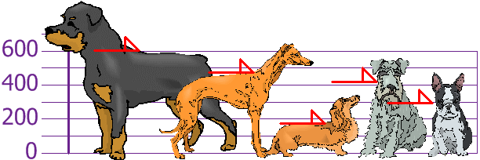
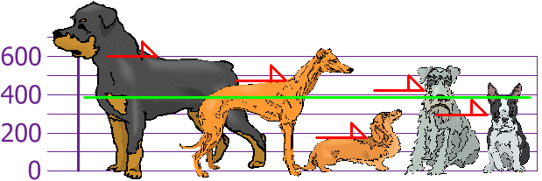
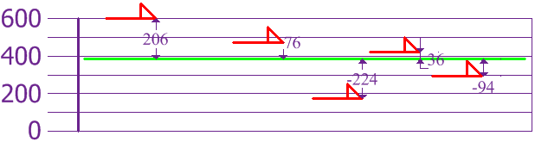
TODO Task
The heights (at the shoulders) are: 600 mm, 470 mm, 170 mm, 430 mm and 300 mm.
Find out the Mean, the Variance, and the Standard Deviation.
Source: https://www.mathsisfun.com/data/standard-deviation.html

Slide 9
calculations
Variance
σ² | = | [206² + 76² + (−224)² + 36² + (−94)² ] / 5
 | = | [42436 + 5776 + 50176 + 1296 + 8836] / 5
 | = | 108520 / 5
Variance | = | 21704
Standard Deviation
σ | = | √21704
 | = | 147.32...
 | = | 147 (to the nearest mm)

Slide 10
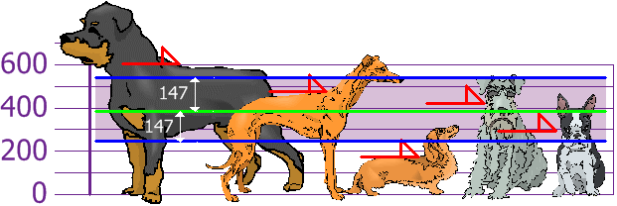
output
Standard Deviation we have a "standard" way of knowing what is normal, and what is extra large or extra small.
Mean =394 , Variance=21704, Standard Deviation=147.
Source: http://mathsisfun.com/data/standard-deviation.html

Slide 11

Calculate the variance
import numpy
speed = [86,87,88,86,87,85,86]
x = numpy.std(speed)
print(x) #0.9035079029052513
x = numpy.var(speed)
print(x) #0.8163265306122449
speed = [86,87,88,86,87,85,86]
Mean = 86.42857142857143
Diff mean= [0.4,1.6,0.4,1.6]
Diff mean sq = [1.6,2.56,1.6,2.56]
Variance = sum [Diff mean sq] / n

Slide 12
Manual vs inbuilt function for variance
# To demonstrate the variance
import numpy
speed = [86,87,88,86,87,85,86]
print("Speed:", speed)
# Step 1: Calculate the mean
m = numpy.mean(speed)
print("Mean:", m)
# Step 2: Calculate the squared differences and store them
squared_diffs = []
for i in speed:
diff = i - m # difference from the mean
squared = diff * diff # square it
squared_diffs.append(float(numpy.mean(squared)))
print("Squared Differences:", squared_diffs)
# Step 3: Compute the average of these squared differences
manual_variance = sum(squared_diffs) / len(speed)
print("Manual Variance:", manual_variance)
# Step 4: Compare with NumPy's result
numpy_variance = numpy.var(speed)
print("NumPy Variance:", numpy_variance)
x = numpy.var(speed)

Slide 13
1.5 Percentiles
where a value sits in relation to the rest of the data.
say “this number is larger than 25% of the other values”.
They’re especially useful when your data isn’t evenly distributed.
Unlike mean and standard deviation, percentiles focus on ranks, not spreads.
Example: data = [15, 20, 35, 40, 50]
25th percentile (Q1): 25% of the values are below 20.
50th percentile (Q2 or median): Half of the values are below 35.
75th percentile (Q3): 75% of the values are below 45.

Slide 14
Percentiles code
import numpy as np
#data = [15,15,20,20,21,21,25,26,25,28]
data = [20,28,15,25,21,21,20,25,25,15]
print("25th percentile:", np.percentile(data, 25)) # Output: 20
print("50th percentile (median):", np.percentile(data, 50)) # Output: 21
print("75th percentile:", np.percentile(data, 75)) # Output: 25

Slide 15
1.6 Data Distribution
To create dummy data sets for testing.
We use the Python module NumPy,
Which comes with a number of methods to create random data sets, of any size.
uniform_data = np.random.uniform(0.0, 5.0, 250)
normal_data = np.random.normal(2.5, 1.0, 250)

Slide 16
Distributions You Can Use with NumPy:
Distribution | Function | Use Case
Uniform | np.random.uniform(low, high, size) | Evenly spread across that range.
Normal (Gaussian) | np.random.normal(loc, scale, size) | Bell-shaped curve; modeling measurement errors or returns in finance
Binomial | np.random.binomial(n, p, size) | Simulating yes/no events like coin tosses, success rates
Poisson | np.random.poisson(lam, size) | Number of events in fixed intervals—like trades per minute
Exponential | np.random.exponential(scale, size) | Time between events (great for latency models or decay)
Lognormal | np.random.lognormal(mean, sigma, size) | Right-skewed data—useful in stock price modeling
Beta | np.random.beta(a, b, size) | Probabilities, often used in Bayesian models

Slide 17
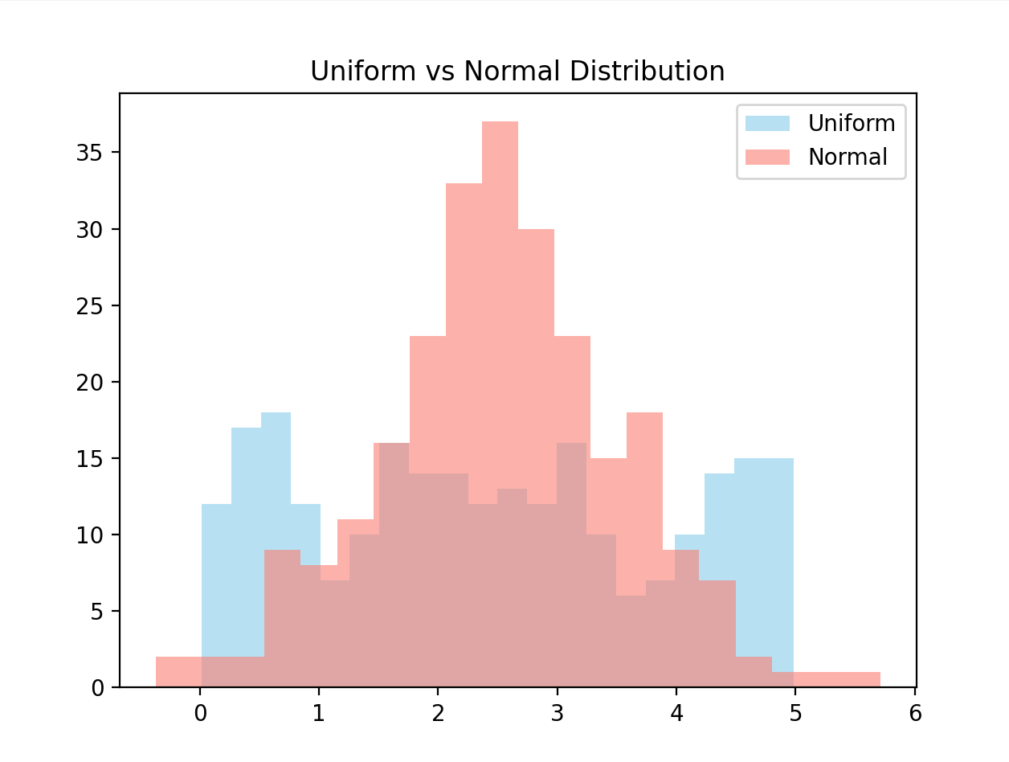
1.6. a) Normal vs Uniform Distribution
import numpy as np
import matplotlib.pyplot as plt
uniform_data = np.random.uniform(0.0, 5.0, 250)
normal_data = np.random.normal(2.5, 1.0, 250)
plt.hist(uniform_data, bins=20, alpha=0.6, label='Uniform', color='skyblue')
plt.hist(normal_data, bins=20, alpha=0.6, label='Normal', color='salmon')
plt.title("Uniform vs Normal Distribution")
plt.legend()
plt.show()
Uniform=> low=0.0, high=5.0:size=250
normal =>loc: Mean, scale: Standard deviation, size

Slide 18
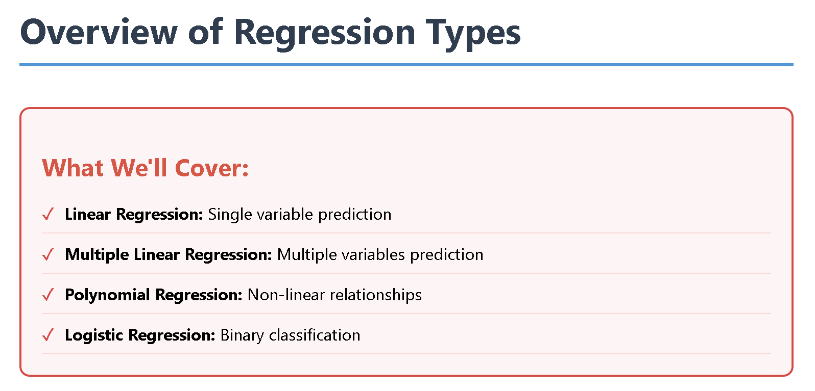

Slide 19
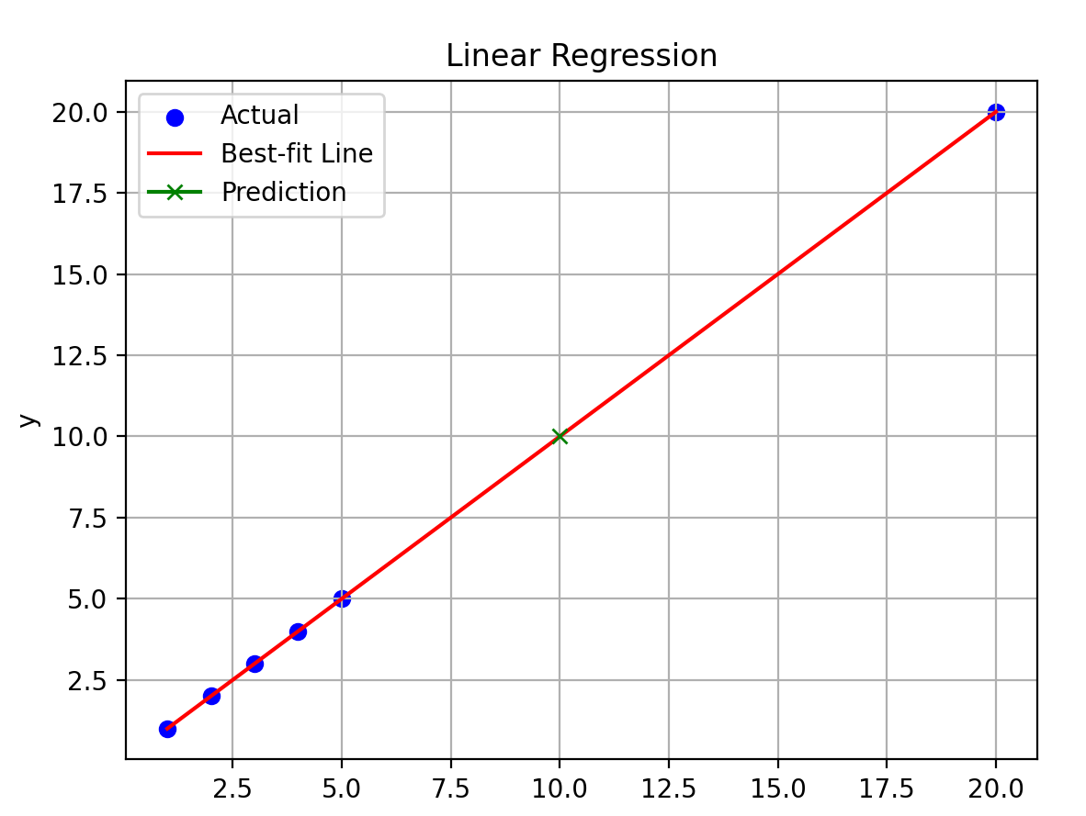
2. Simple Linear Regression
Regression
Used when you try to find the relationship between variables.
The relationship is used to predict the outcome of future events.
Linear Regression
Uses the relationship between the data-points to draw a straight line through all them.
This line can be used to predict future values.

Slide 20
Contd..
It shows a linear relationship between a dependent (y) and one or more independent (X) variables
It finds how the value of the dependent variable is changing according to the value of the independent variable.
Makes predictions for continuous/real or numeric variables such as sales, salary, age, product price, etc.
Provides a sloped straight line representing the relationship between the variables.
Source: https://www.meritshot.com/introduction-to-supervised-machine-learning/

Slide 21
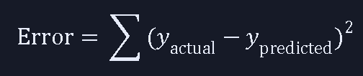
1.1 📈 Equation of the Line:
y=mx+c
y: predicted value (dependent variable)
x: input value (independent variable)
m: slope (how much y changes when x increases)
c: intercept (where the line crosses the y-axis)
🔍 Error = Residuals
This is called Least Squares Method.

Slide 22
Linear regression : Graph

Slide 23
x.reshape()
x.reshape() is a method primarily used with NumPy arrays to change the shape (dimensions) of an array without altering its underlying data.
import numpy as np
a = np.array([1,2,3,4,5,6,7,8])
a = a.reshape(2, 4) # Reshapes to a 2x4 matrix
print(a)
#[[1 2 3 4]
# [5 6 7 8]]
a = a.reshape(-1) # Flattens the array to a 1D array
# [1 2 3 4 5 6 7 8]
print(a)
b = a.reshape(2,-1) # NumPy calculates the second dimension as 4
print(b)
#[[1 2 3 4]
# [5 6 7 8]]
b = a.reshape(1,-1)
print(b)
# [[1 2 3 4 5 6 7 8]]
b = a.reshape(-1,1)
print(b)
#[[1]
# [2]
# [3]
# [4]
# [5]
# [6]
# [7]
# [8]]

Slide 24
x.reshape(-1, 1)
sklearn expects the input x to be a 2D array of shape (n_samples, n_features).
np.array([1, 2, 3, 4, 5])
# 1-D array of shape (5,), which means: 5 samples, But no clear feature dimension.
x.reshape(-1, 1)
# -1 tells NumPy to infer the number of rows (samples)
# 1 sets the number of columns (features),
So, it transforms:
[1, 2, 3, 4, 5] → [[1], [2], [3], [4], [5]]
Now the shape is (5, 1) → ✅ 5 samples, 1 feature
-1 is used as a dimension, NumPy automatically calculates the size of that dimension based on the total number of elements in the original array
Method | Purpose
.reshape(-1, 1) | Converts 1D array to 2D column vector
Required by | sklearn models like LinearRegression
Shape becomes | (n_samples, n_features)

Slide 25
REsource
Linear Regression in 3 Minutes
https://www.youtube.com/watch?v=3dhcmeOTZ_Q

Slide 26
Linear regression : Code
import numpy as np
import matplotlib.pyplot as plt
from sklearn.linear_model import LinearRegression
# Sample data
X = np.array([1, 2, 3, 4, 5,20]).reshape(-1, 1) # Independent variable
#y = np.array([2, 4, 5, 4, 5]) # Dependent variable
y = np.array([1, 2, 3, 4, 5,20]) # Dependent variable
model = LinearRegression() # Create and fit the model
model.fit(X, y) # Get slope and intercept/train
m,c = model.coef_[0],model.intercept_
print(f"Equation of line: y = {m:.2f}x + {c:.2f}")
y_pred = model.predict(X) # Predict values: against original x values.
xx=np.array([[10]])
yy=model.predict(xx)

Slide 27
Linear regression : Code plot
# Plot
plt.scatter(X, y, color='blue', label='Actual')
plt.plot(X, y_pred, color='red', label='Best-fit Line')
plt.plot(xx, yy, color='green', label='Prediction', marker='x')
plt.title('Linear Regression')
plt.xlabel('x')
plt.ylabel('y')
plt.legend()
plt.grid(True)
plt.show()

Slide 28
Reference link & MSE
https://www.mathsisfun.com/data/least-squares-calculator.html
In linear regression, Mean Squared Error (MSE) is a crucial metric for evaluating model performance by quantifying the average squared difference between predicted and actual values.
A lower MSE indicates a better fit, suggesting the model's predictions are closer to the true values.
Significance of MSE:
Model Evaluation
Model Selection
Optimization

Slide 29
🧠 2. Multiple Linear Regression
It models the relationship between two or more independent variables and a single dependent variable.
y=m₁x₁+m₂x₂+⋯+m_{n} x_{n}+c
x₁,x₂,...,x_{n} : input features
m₁,m₂,...,m_{n} : coefficients (slopes)
c : intercept
y : predicted output

Slide 30
🔍 Simple vs Multiple Linear Regression
Aspect | Simple Linear Regression | Multiple Linear Regression
📥 Input X_train | One feature (1D array or single column) | Multiple features (2D array or DataFrame with >1 column)
📐 Equation | 𝑦 =𝛽₀+𝛽₁𝑥 | 𝑦=𝛽₀ + 𝛽₁ 𝑥₁ + 𝛽₂ 𝑥₂ +⋯+ 𝛽_{𝑛} 𝑥_{𝑛}
🧠 Model Complexity | Captures linear relationship between one feature and target | Captures combined linear effects of multiple features
📊 Use Case | When only one predictor is relevant or available | When multiple predictors influence the outcome
🧮 Coefficients | One slope (β₁) and one intercept (β₀) | One intercept and multiple slopes (β₁ to βₙ)
Output | Line in 2D | Hyperplane in nD

Slide 31
Syntax difference
Linear Regression | Multiple Linear Regression
model_simple.coef_ → array with one value | model_multiple.coef_ → array with N values (one per feature)
fits a line in 2D space | fits a hyperplane in n-dimensional space.
# Simple Linear Regression
X_simple = X_train[['bmi']] # Only one feature
model_simple = LinearRegression().fit(X_simple, y_train)
# Multiple Linear Regression
X_multiple = X_train # All features
model_multiple = LinearRegression().fit(X_multiple, y_train)

Slide 32
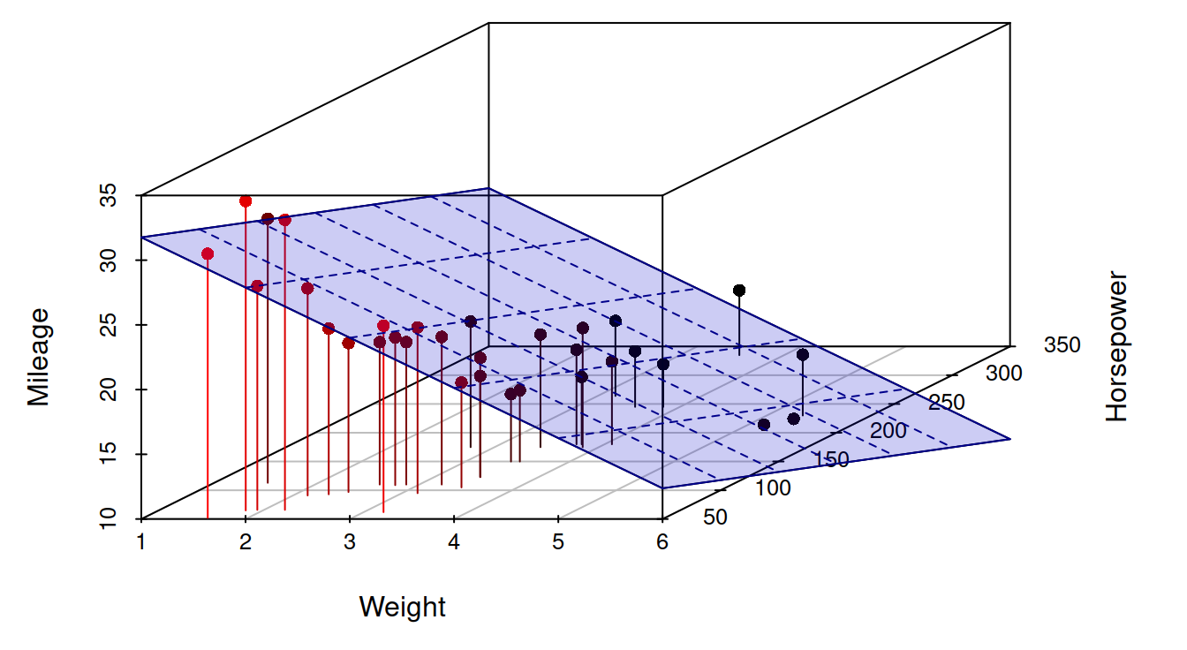
Multiple Linear Regression (MLR)
MLR assumes there is a linear relationship between the dependent and independent variables, that the independent variables are not highly correlated, and that the variance of the residuals is constant.
Figure: https://www.openforecast.org/adam/linearRegression.html

Slide 33
Implementation MLR
#Step 1: Load the Dataset
from sklearn.datasets import load_diabetes
import pandas as pd
# Load dataset
diabetes = load_diabetes()
X = pd.DataFrame(diabetes.data, columns=diabetes.feature_names)
y = pd.Series(diabetes.target, name='disease_progression')
#Step 2: Explore the Data
print(X.head())
print(y.describe())
print(X.corr()) # Check multicollinearity
print(X.columns)
#Index(['age', 'sex', 'bmi', 'bp', 's1', 's2', 's3', 's4', 's5', 's6'], dtype='object')

Slide 34
Contd…
# Step 3: Split the Data
from sklearn.model_selection import train_test_split
#80% training, 20% testing ,random_state ensures reproducibility
X_train, X_test, y_train, y_test = train_test_split(X, y, test_size=0.2, random_state=42)
# Step 4: Train the Model
from sklearn.linear_model import LinearRegression
model = LinearRegression()
model.fit(X_train, y_train)
Training Data
Purpose: The training dataset is used to train the machine learning model.
Process: The model learns patterns and relationships within the training data, adjusting its internal parameters to make predictions.

Slide 35
Contd…
# Step 5: Evaluate the Model
from sklearn.metrics import mean_squared_error, r2_score
y_pred = model.predict(X_test)
mse = mean_squared_error(y_test, y_pred)
r2 = r2_score(y_test, y_pred)
print(f"Mean Squared Error: {mse:.2f}")
print(f"R² Score: {r2:.2f}")
# Step 6: Interpret Coefficients
coefficients = pd.Series(model.coef_, index=X.columns)
print(coefficients.sort_values(ascending=False))
#Shows which features have the most positive/negative impact on the target.

Slide 36
🧪 Example: 2
Let’s say you’re predicting a student’s final score based on:
Hours studied (x₁)
Attendance (x₂)
Previous test score (x₃)

Slide 37
Slicing in python
my_list = [0, 1, 2, 3, 4, 5, 6, 7, 8, 9]
my_string = "Hello Python"
# Basic slicing
print(my_list[2:5]) # Output: [2, 3, 4] (elements from index 2 up to, but not including, index 5)
print(my_string[0:5]) # Output: Hello
# Slicing to the end
print(my_list[5:]) # Output: [5, 6, 7, 8, 9]
# Slicing from the beginning
print(my_list[:3]) # Output: [0, 1, 2]
# Slicing with a step
print(my_list[0:10:2]) # Output: [0, 2, 4, 6, 8] (every other element)
# Reversing a sequence
print(my_list[::-1]) # Output: [9, 8, 7, 6, 5, 4, 3, 2, 1, 0]
# Negative indices
print(my_list[-3:]) # Output: [7, 8, 9] (last three elements)
print(my_string[:-7]) # Output: Hello

Slide 38
Slicing demo 2
import numpy as np
X = np.array([[1, 2, 3],
[4, 5, 6],
[7, 8, 9]])
sliced_X = X[:, :2]
print(sliced_X)
X[:, :2] => Represents the multi-dimensional data structure
X[:, :2]: => (before the comma) all elements along the first dimension (rows) should be selected.
X[:, :2] ,: => This comma separates the slicing operations for different dimensions.
This indicates a slice along the second dimension (columns).
It means to select elements from the beginning of this dimension up to, but not including, the element at index 2. This effectively selects the elements at index 0 and index 1 for that dimension.

Slide 39
Multiple linear regression code
import numpy as np
import pandas as pd
from sklearn.linear_model import LinearRegression
# Sample data (5 students, 3 features) : # hours, attendance, previous score
X = np.array([ [5, 90, 80],[3, 85, 70],[8, 95, 88],[2, 80, 65],[6, 92, 85] ]) y = np.array([82, 75, 90, 70, 88]) # Final scores
model = LinearRegression() # Create and fit the model
model.fit(X, y)
print("Coefficients:", str(model.coef_) + "Intercept: " + str(model.intercept_))
# Predict for a new student
new_student = np.array([[4, 88, 78]])
predicted_score = model.predict(new_student)
print("Predicted Final Score:", predicted_score[0])

Slide 40
Plot
import matplotlib.pyplot as plt
from mpl_toolkits.mplot3d import Axes3D
X_2D = X[:, :2] # Use only first two features for 3D plot x[start:end:step]
model.fit(X_2D, y) fig = plt.figure()
ax = fig.add_subplot(111, projection='3d')
ax.scatter(X_2D[:, 0], X_2D[:, 1], y, color='blue', label='Actual') x_surf, y_surf = np.meshgrid( # Create meshgrid for surface
np.linspace(X_2D[:,0].min(), X_2D[:,0].max(), 10),
np.linspace(X_2D[:,1].min(), X_2D[:,1].max(), 10)
)
z_surf = model.predict(np.c_[x_surf.ravel(), y_surf.ravel()]).reshape(x_surf.shape)
# Plot the prediction point
ax.scatter(new_student[0, 0], new_student[0, 1], predicted_score,
color='green', s=100, marker='^', label='Predicted Point') # Plot regression surface
ax.plot_surface(x_surf, y_surf, z_surf, color='red', alpha=0.5)
ax.set_xlabel('Hours Studied')
ax.set_ylabel('Attendance')
ax.set_zlabel('Final Score')
plt.title('Multiple Linear Regression (2 Features)')
ax.legend()
plt.show()

Slide 41
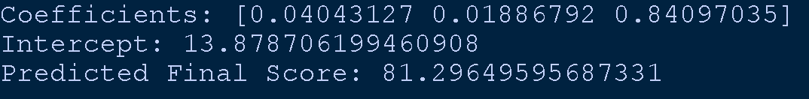
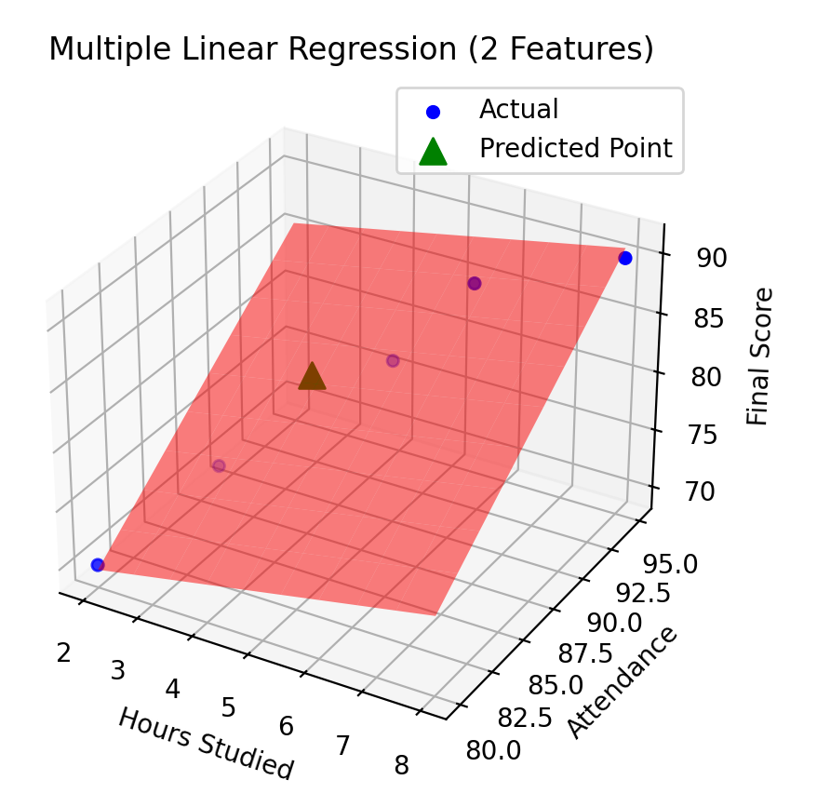
output

Slide 42
🤖 Why We Split Data in Machine Learning
1. To Evaluate Generalization
To know it will work well on new, unseen data?
Train/Test split simulates this: you train on one portion, and test on another to see how well your model generalizes.
2. To Detect Overfitting
A model can fit the training data too well — capturing noise instead of the true pattern.
If performance drops significantly on the test set, it’s a sign of overfitting.
This is especially important for complex models (e.g. high-degree polynomials).
3. To Tune and Compare Models
You might try different algorithms (Linear vs Polynomial vs Ridge).
Without a test set, you can’t objectively compare which one performs better.
You need a separate set to validate your choices.

Slide 43
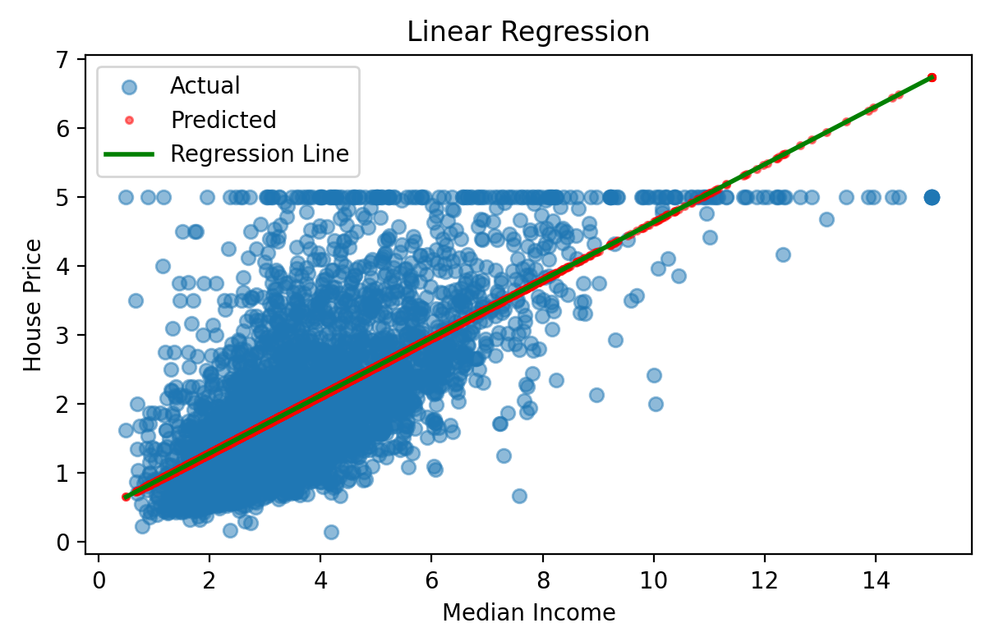
Linear Regression model

Slide 44
Model Performance: MAE
Mean Absolute Error (MAE): Average of absolute differences between actual and predicted values. MAE = (1/n) × Σ|yi - ŷi|
Example:
Actual: [2, 4, 6]
Predicted: [1, 5, 7]
Errors: |2-1| + |4-5| + |6-7| = 1 + 1 + 1 = 3
MAE = 3/3 = 1.0

Slide 45
Model Performance: MSE
Mean Squared Error (MSE): Average of squared differences between actual and predicted values. MSE = (1/n) × Σ(yi - ŷi)²
Example:
Actual: [2, 4, 6]
Predicted: [1, 5, 7]
Errors²: (2-1)² + (4-5)² + (6-7)² = 1 + 1 + 1 = 3
MSE = 3/3 = 1.0

Slide 46
Model Performance: RMSE
Root Mean Squared Error (RMSE):
RMSE = √MSE
= √[(1/n) × Σ(yi - ŷi)²]
Example
Using MSE = 1.0 from above
RMSE = √1.0
= 1.0

Slide 47
Model Performance: R-squared
R-squared (R²) Score: Proportion of variance in the target variable explained by the model. R² = 1 - (SS_res / SS_tot) or R² = 1 - (MSE / Var(y))
Where:
SS_res = Σ(yi - ŷi)² [Sum of Squares of Residuals]
SS_tot = Σ(yi - ȳ)² [Total Sum of Squares]
ȳ = mean of actual values

Slide 48
Actual: [1, 2, 3, 4, 5], Mean = 3
Predicted: [1.1, 2.2, 2.8, 4.1, 4.8]
SS_res = (1-1.1)² + (2-2.2)² + (3-2.8)² + (4-4.1)² + (5-4.8)²
= 0.01 + 0.04 + 0.04 + 0.01 + 0.04 = 0.14
SS_tot = (1-3)² + (2-3)² + (3-3)² + (4-3)² + (5-3)²
= 4 + 1 + 0 + 1 + 4 = 10
R² = 1 - (SS_res / SS_tot) = 1 - (0.14/10) = 1 - 0.014 = 0.986

Slide 49
Polynomial Regression Model
Key Differences from Linear Regression:
Instead of fitting: y = mx + b (linear), It fits: y = ax² + bx + c (quadratic)
Uses Polynomial Features: Transforms input x into [1, x, x²] for degree=2
Pipeline: Combines polynomial transformation with linear regression
Curved line: Instead of straight line, fits a polynomial curve
Better fit: Can capture non-linear relationships in data

Slide 50
Machine Learning Methods: Regression
1. Linear Regression
Linear regression models the relationship between a dependent variable and one independent variable using a straight line.
It assumes a linear relationship of the form: y = mx + b, where m is the slope and b is the y-intercept.
This method finds the best-fitting line that minimizes the sum of squared residuals.
2. Multiple Linear Regression
Multiple linear regression extends simple linear regression to handle multiple independent variables.
The relationship becomes: y = b₀ + b₁x₁ + b₂x₂ + ... + bₙxₙ.
This allows modeling complex relationships where the target variable depends on several factors simultaneously.

Slide 51
Machine Learning Methods: Regression
3. Polynomial Regression
Polynomial regression captures non-linear relationships by using polynomial terms of the independent variables.
For example, a quadratic relationship: y = b₀ + b₁x + b₂x².
Despite using polynomial terms, it's still considered linear regression because it's linear in the coefficients.
4. Logistic Regression
Logistic regression is used for binary classification problems.
Instead of predicting continuous values, it predicts probabilities using
the logistic (sigmoid) function: p = 1/(1 + e^(-z)), where z is the linear combination of features.
The output is bounded between 0 and 1.

Slide 52
Consider the data table for understanding of the Regression
House | Size (sq ft) | Bedrooms | Age (years) | Price ($1000s)
1 | 1000 | 2 | 5 | 150
2 | 1200 | 3 | 3 | 180
3 | 800 | 2 | 8 | 120
4 | 1500 | 4 | 2 | 220
5 | 1100 | 3 | 6 | 160

Slide 53
Recap And Forward
Simple Linear Regression – One input variable, straight-line prediction.
Multiple Linear Regression – Several input variables.
Polynomial Regression – Curved line predictions.
Logistic Regression – Predicts probabilities for classification tasks.
Ordinary Least Squares (OLS) – Method to find the “best” regression line.
Correlations – Measure strength & direction of relationship.

Slide 54
1. Linear Regression (Single Variable)
Size (x) | Price (y)
1000 | 150
1200 | 180
800 | 120
1500 | 220
1100 | 160
Objective: Predict house price based on size (in 1000 sq ft).
y = β₀ + β₁x
design matrix X (with bias term, (1’s) for intercept) # shape: (3, 2)
X = [1 1000]
[1 1200]
[1 800]
[1 1500]
[1 1100]
Target vector # shape: (5, 1) :
y = [150]
[180]
[120]
[220]
[160]
🧱 Add a Bias Column to Matrix X !!
To include β₀ in matrix math, we add a column of 1s to the design matrix X; not 0’s.
The bias term is the intercept of the regression model.
Without it, your model is forced to go through the origin (0,0), which is often incorrect

Slide 55
📐 Coefficients Calculation
Using Normal Equation: β = (X^T X) ^(-1) X^T y
Step 1: Calculate X^T X
Step 2: Calculate (X^T X)^(-1)
Step 3: Calculate X^T y
Step 4: Calculate β

Slide 56
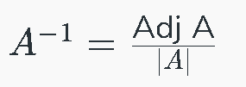
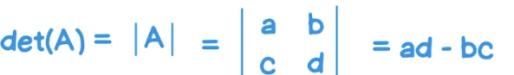
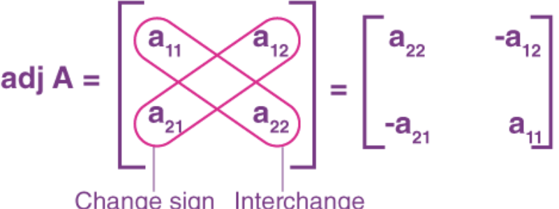
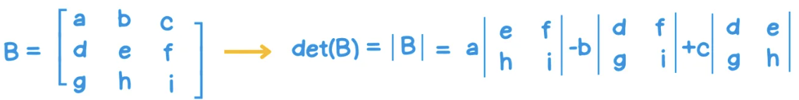
β = (X^T X) ^(-1) X^T y
Step 1: Calculate (X^T)* X
X^T = [1 1 1 1 1 ]
[1000 1200 800 1500 1100]
(X^T)* X = [5 5600 ]
[5600 6760000]
X^T :The transpose of a matrix is a new matrix formed by interchanging the rows and columns of the original matrix
X = [1 1000]
[1 1200]
[1 800]
[1 1500]
[1 1100]
Step 2: Calculate (X^T X)^(-1)
det(X^T X) = 5 × 6760000 - 5600² = 33800000 - 31360000 = 2440000
(X^T X)^(-1) = 1/2440000 × [6760000 -5600]
[-5600 5 ]
= [2.770 -0.00230]
[-0.00230 0.00000205]
A⁻¹, is another matrix that, when multiplied by the original matrix A, results in the identity matrix

Slide 57
β = (X^T X) ^(-1) X^T y
X^T = [1 1 1 1 1 ]
[1000 1200 800 1500 1100]
Step 3: Calculate X^T y
X^T y = [1 1 1 1 1 ] × [150]
[1000 1200 800 1500 1100] [180]
[120]
[220]
[160]
= [830 ]
[928000]
Target vector # shape: (5, 1) :
y = [150]
[180]
[120]
[220]
[160]
Coefficients:
β₀ (intercept) = 67.69
β₁ (size coefficient) = 0.095
Equation: Price = 67.69 + 0.095 × Size
Step 4: Calculate β
β = [2.770 -0.00230] × [830 ] = [67.69]
[-0.00230 0.00000205] [928000] [0.095]

Slide 58
Prediction and Verification
For house with 1300 sq ft: Prediction: Price = 67.69 + 0.0946 × 1300 = 190.67 ($190,670)
Verification with training data:
House 1: 67.69 + 0.0946 × 1000 = 162.29 (Actual: 150, Error: 12.29)
House 2: 67.69 + 0.0946 × 1200 = 181.21 (Actual: 180, Error: 1.21)

Slide 59
import pandas as pd
from sklearn.linear_model import LinearRegression
import matplotlib.pyplot as plt
# Example dataset: House Size vs Price
data = pd.DataFrame({
'Size': [500, 600, 700, 800, 900], # in square feet
'Price': [150, 180, 200, 230, 260] # in thousands
})
# Separate into input (X) and output (y)
X = data[['Size']] # 2D array
y = data['Price'] # 1D array
# Create & train the model
model = LinearRegression()
model.fit(X, y)
# Get slope and intercept
print(f"Slope (m): {model.coef_[0]}")
print(f"Intercept (c): {model.intercept_}")

Slide 60
# Prediction with feature name
new_data = pd.DataFrame({'Size': [750]})
predicted_price = model.predict(new_data)
print(f"Predicted Price for 750 sqft: {predicted_price[0]} thousand")
# Plot
plt.scatter(X, y, color='blue', label='Data Points')
plt.plot(X, model.predict(X), color='red', label='Best Fit Line')
plt.scatter(new_data, predicted_price, color='red', label='Data Points')
plt.xlabel('Size (sqft)')
plt.ylabel('Price (thousand)')
plt.legend()
plt.show()
Code Walkthrough
LinearRegression() → creates a regression model.
.fit(X, y) → learns slope & intercept from the data.
.predict() → predicts for new data points.
plt.scatter() → shows actual data points.
plt.plot() → shows best fit line.

Slide 61
2. Multiple Linear Regression
Objective: Predict house price based on size, bedrooms, and age.
Matrix Formation:
X = [1 1000 2 5]
[1 1200 3 3]
[1 800 2 8]
[1 1500 4 2]
[1 1100 3 6]
y = [150]
[180]
[120]
[220]
[160]
Coefficients Calculation:
Using Normal Equation: β = (X^T X) ^(-1) X^T y
Step 1: Calculate X^T X
Step 2: Calculate (X^T X)^(-1)
Step 3: Calculate X^T y
Step 4: Calculate β

Slide 62
(X^T X) ^(-1)
Step 1: Calculate X^T X
X = [1 1000 2 5]
[1 1200 3 3]
[1 800 2 8]
[1 1500 4 2]
[1 1100 3 6]
X^T = [1 1 1 1 1 ]
[1000 1200 800 1500 1100]
[5 3 8 2 6 ]
Step 2: Calculate (X^T X)^(-1)
X^T X = [5 5600 14 24 ]
[5600 6760000 16800 28400]
[14 16800 42 66 ]
[24 28400 66 134 ]
(X^T X)^(-1) = [15.23 -0.0119 -0.524 -0.312]
[-0.0119 0.00001 0.0005 0.0003]
[-0.524 0.0005 0.156 -0.028]
[-0.312 0.0003 -0.028 0.076]

Slide 63
Step 3: Calculate X^T y
X^T y = [830 ]
[924000]
[2380 ]
[3980 ]
Step 4: Calculate β
β = [52.14 ] (intercept)
[0.0823] (size coefficient)
[15.67 ] (bedrooms coefficient)
[-2.45 ] (age coefficient)
Equation:
Price = 52.14 + 0.0823×Size + 15.67×Bedrooms - 2.45×Age
Prediction and Verification
For house with 1300 sq ft, 3 bedrooms, 4 years old:
Prediction: Price = 52.14 + 0.0823×1300 + 15.67×3 - 2.45×4 = 192.25 ($192,250)

Slide 64
import pandas as pd
from sklearn.linear_model import LinearRegression
import matplotlib.pyplot as plt
# Example dataset: House Size vs Price
data = pd.DataFrame({
'Size': [500, 600, 700, 800, 900],
'Bedrooms': [1, 2, 2, 3, 3],
'Price': [150, 180, 200, 230, 260]
})
# Separate into input (X) and output (y)
X = data[['Size', 'Bedrooms']] # 2D array
y = data['Price'] # 1D array
# Create & train the model
model = LinearRegression()
model.fit(X, y)
# Get slope and intercept
# Multiple Linear Regression
print("Coefficients:", model.coef_)
print("Intercept:", model.intercept_)
# Define new_data before using it
new_data = pd.DataFrame({'Size': [750], 'Bedrooms': [3]})
predicted_price = model.predict(new_data)
print(f"Predicted Price for Size=750 & Bedrooms=3: {predicted_price[0]} thousand")

Slide 65
# Create grid for 3D surface
from mpl_toolkits.mplot3d import Axes3D
# code generates 10 evenly spaced values between the minimum and maximum
import numpy as np
size_range = np.linspace(data['Size'].min(), data['Size'].max(), 10)
bed_range = np.linspace(data['Bedrooms'].min(), data['Bedrooms'].max(), 10)
# np.meshgrid(): to create coordinate grids from 1-D arrays.
size_grid, bed_grid = np.meshgrid(size_range, bed_range)
# Predictions for the whole surface
# raveled (flattened) arrays column-wise.
# (e.g., size and number of bedrooms) for prediction.
grid_points = pd.DataFrame({
'Size': size_grid.ravel(),
'Bedrooms': bed_grid.ravel()
})
price_pred = model.predict(grid_points).reshape(size_grid.shape)
# 3D Plot
fig = plt.figure(figsize=(8,6))
ax = fig.add_subplot(111, projection='3d')
ax.scatter(data['Size'], data['Bedrooms'], y, color='blue', label="Data Points")
ax.plot_surface(size_grid, bed_grid, price_pred, color='green', alpha=0.5)

Slide 66
# Highlight your prediction in red
ax.scatter(new_data['Size'], new_data['Bedrooms'], predicted_price, color='red', s=100, label="Prediction")
ax.set_xlabel("Size (sqft)")
ax.set_ylabel("Bedrooms")
ax.set_zlabel("Price (thousand)")
plt.legend()
plt.show()

Slide 67
🔎 Why Scatter Plot Doesn’t Work Directly Multiple Linear Regression
If you have 2 input features (e.g. Size and Bedrooms), the model equation is:
y=m1⋅Size+m2⋅Bedrooms+c
That’s a plane in 3D space (X, Y, Z).
If you have 3+ input features → it’s no longer possible to plot directly because it lives in higher dimensions.

Slide 68
🧠 Key Takeaway
1 feature → regression line (2D)
2 features → regression plane (3D)
3+ features → no direct visualization, use bar charts or partial plots

Slide 69
3. Polynomial Regression
Objective: Predict house price using polynomial features of size (degree 2).
Matrix Formation: Add polynomial terms: size²
1 x x²
X = [1 1000 1000000]
[1 1200 1440000]
[1 800 640000]
[1 1500 2250000]
[1 1100 1210000]
y = [150]
[180]
[120]
[220]
[160]
Coefficients Calculation:
Using β = (X^T X)^(-1) X^T y
House | Size (sq ft) x | Price ($1000s) y
1 | 1000 | 150
2 | 1200 | 180
3 | 800 | 120
4 | 1500 | 220
5 | 1100 | 160

Slide 70
Using β = (X^T X)^(-1) X^T y
In Python: Whenever you use polynomial regression, you must pass data through poly.transform() before prediction.
Step 1: Calculate X^T X
X^T X = [5 5600 7540000 ]
[5600 6760000 9128000000]
[7540000 9128000000 12359600000000]
Step 2: Solve for coefficients (computational)
β = [185.71 ] (intercept)
[-0.0714] (size coefficient)
[0.0000567] (size² coefficient)
Equation: Price = 185.71 - 0.0714×Size + 0.0000567×Size²
Prediction and Verification
For house with 1300 sq ft: Prediction: Price = 185.71 - 0.0714×1300 + 0.0000567×1300² = 195.59 ($195,590)

Slide 71
import pandas as pd
from sklearn.linear_model import LinearRegression
import matplotlib.pyplot as plt
# Example dataset: House Size vs Price
data = pd.DataFrame({
'Size': [500, 600, 700, 800, 900], # in square feet
'Price': [150, 180, 200, 230, 260] #in thousands
})
# Separate into input (X) and output (y)
X = data[['Size']] # 2D array
from sklearn.preprocessing import PolynomialFeatures
poly = PolynomialFeatures(degree=2)
# Model expects 2 features (Size and Size²) plus the bias term.
# For More fitting increase the degree
X_poly = poly.fit_transform(X)
y = data['Price'] # 1D array
# Create & train the model
model = LinearRegression()
model.fit(X_poly, y)
# Get slope and intercept
print(f"Slope (m): {model.coef_[0]}")
print(f"Intercept (c): {model.intercept_}")

Slide 72
# Prediction with feature name
new_data = pd.DataFrame({'Size': [750]})
# Transform new_data into polynomial features
new_data_poly = poly.transform(new_data)
predicted_price = model.predict(new_data_poly)
print(f"Predicted Price for 750 sqft: {predicted_price[0]} thousand")
#Plot
plt.scatter(X, y, color='blue', label='Data Points')
# Invalid; poly reg, model is trained on the expanded features
#plt.plot(X, model.predict(X), color='green', label='Best Fit Line')
# We must transform any input using poly.transform(...)
X_range = pd.DataFrame({'Size': range(500, 901)}) # 500 → 900
X_range_poly = poly.transform(X_range)
plt.plot(X_range, model.predict(X_range_poly), color='green', label='Polynomial Fit')
plt.scatter(new_data, predicted_price, color='red', label='Data Points')
plt.xlabel('Size (sqft)')
plt.ylabel('Price (thousand)')
plt.legend()
plt.show()

Slide 73
4. Logistic Regression
Linear Regression would predict the exact price (like $150,000, $180,000, $220,000...)
Logistic Regression predicts the probability of being expensive (like 30%, 85%, 95%)
The Problem with Regular Linear Regression
If we use regular linear regression for classification:
500 sq ft house : -20% chance of being expensive ❌ (Negative probability? Impossible!)
3000 sq ft house : 150% chance of being expensive ❌ (More than 100%? Impossible!)
Problem: Linear regression can give impossible answers for yes/no questions!
The Logistic Solution
Logistic regression keeps probabilities between 0% and 100% using a special "S-shaped" curve.

Slide 74
The Magic S-Curve 📈
Think of logistic regression like a house price classifier
House Size: 800 sq ft ---- 1200 sq ft ---- 1600 sq ft
Expensive Chance: 10% ---- 50% ---- 90%
↓ ↓ ↓
Almost 50-50 chance Almost
Affordable Expensive

Slide 75
Let's predict if houses are expensive based on their size:
Step 1: Convert to Numbers
House | Size (sq ft) | Price ($1000s) | Category
1 | 1000 | 150 | Affordable
2 | 1200 | 180 | Expensive
3 | 800 | 120 | Affordable
4 | 1500 | 220 | Expensive
5 | 1100 | 160 | Affordable
House | Size (sq ft) | Category (0/1)
1 | 1000 | 0
2 | 1200 | 1
3 | 800 | 0
4 | 1500 | 1
5 | 1100 | 0
Affordable = 0, Expensive = 1
Classification Rule: If price > $170k → Expensive, else → Affordable

Slide 76
Step 2: The Logistic Formula
Probability = 1 ÷ (1 + e^(-z)) ; where: z = a + b × (house size)
a = starting point (how expensive houses are in general)
b = how much each extra sq ft increases the chance of being expensive
e = a special number (≈ 2.718, like π but different)
Step 3: Finding the Best Values
The computer tries different values of a and b until it finds the best fit:
After many calculations, it finds: a = -4.82 and b = 0.0044
So our formula becomes: z = -4.82 + 0.0044 × (house size)
The "e" in our formula (e^(-z)) is called Euler's number (approximately 2.718)

Slide 77
Calculate 'a' and 'b' in Logistic Regression
Trial and Error (But Smart!)
Starts with a guess (usually a = 0, b = 0)
Sees how wrong the predictions are
Adjusts the values slightly
Repeats until it can't improve anymore.
(This process is called Gradient Descent - think of it like rolling a ball down a hill to find the bottom!)
Step 2: Calculate Predictions
Formula: Probability = 1 ÷ (1 + e^(-z)),
Where: z = a + b × size = 0 + 0 × size = 0
For ALL houses: z = 0
Therefore: Probability = 1 ÷ (1 + e^0) = 1 ÷ (1 + 1) = 0.5 = 50%
House | Size | z | Probability | Target | Error
1 | 1000 | 0 | 50% | 0 | 0.5
2 | 1200 | 0 | 50% | 1 | -0.5
3 | 800 | 0 | 50% | 0 | 0.5
4 | 1500 | 0 | 50% | 1 | -0.5
5 | 1100 | 0 | 50% | 0 | 0.5
ITERATION 1: Starting Point
Step 1: Initial Guess
Starting values: a = 0, b = 0
Error = Predicted - Actual

Slide 78
Step 3: Calculate How Wrong We Are
Cost Function: J = -1/m × Σ[y×log(p) + (1-y)×log(1-p)] For each house:
House 1: -(0×log(0.5) + 1×log(0.5)) = -log(0.5) = 0.693
House 2: -(1×log(0.5) + 0×log(0.5)) = -log(0.5) = 0.693
House 3: -(0×log(0.5) + 1×log(0.5)) = -log(0.5) = 0.693
House 4: -(1×log(0.5) + 0×log(0.5)) = -log(0.5) = 0.693
House 5: -(0×log(0.5) + 1×log(0.5)) = -log(0.5) = 0.693
No. | z | Prob. | Target (y) | Error
1 | 0 | 50% | 0 | 0.5
2 | 0 | 50% | 1 | -0.5
3 | 0 | 50% | 0 | 0.5
4 | 0 | 50% | 1 | -0.5
5 | 0 | 50% | 0 | 0.5
Total Cost: J = (0.693 + 0.693 + 0.693 + 0.693 + 0.693) ÷ 5 = 0.693
Step 4: Calculate the Direction to Move (Gradients)
The Question: Should we increase or decrease 'a' and 'b'?

Slide 79
Why Gradient Descent is Needed
Unlike linear regression where we have the closed-form solution β = (X^T X)^(-1) X^T y, logistic regression uses the sigmoid function which creates a non-linear optimization problem.
The sigmoid function p = 1/(1 + e^(-Xβ)) cannot be solved algebraically.
Gradient Formula:
∂J/∂a = (1/m) × Σ(predicted - actual)
∂J/∂b = (1/m) × Σ(predicted - actual) × size
For 'a' (intercept): ∂J/∂a = (1/5) × (0.5 + (-0.5) + 0.5 + (-0.5) + 0.5) = (1/5) × 0.5 = 0.1
For 'b' (size coefficient): ∂J/∂b = (1/5) × [(0.5×1000) + (-0.5×1200) + (0.5×800) + (-0.5×1500) + (0.5×1100)] = (1/5) × [500 - 600 + 400 - 750 + 550] = (1/5) × 100 = 20
Step 5: Update the Values: Update Rule:
New_a = Old_a - (learning_rate × ∂J/∂a)
New_b = Old_b - (learning_rate × ∂J/∂b)
Learning Rate: Let's use α = 0.01 (a small step size)
New Values:
a = 0 - (0.01 × 0.1) = 0 - 0.001 = -0.001
b = 0 - (0.01 × 20) = 0 - 0.2 = -0.2

Slide 80
ITERATION 2: First Improvement
Problem! All probabilities are essentially 0%. This means we're predicting ALL houses are affordable, but houses 2 and 4 are actually expensive!
What Happened? Our learning rate might be too big, causing us to overshoot!
Step 1: New Values
Current values: a = -0.001, b = -0.2
Step 2: Calculate New Predictions
z = -0.001 + (-0.2) × size
House | Size | z Calculation | z | Probability
1 | 1000 | -0.001 + (-0.2×1000) | -200.001 | ≈ 0%
2 | 1200 | -0.001 + (-0.2×1200) | -240.001 | ≈ 0%
3 | 800 | -0.001 + (-0.2×800) | -160.001 | ≈ 0%
4 | 1500 | -0.001 + (-0.2×1500) | -300.001 | ≈ 0%
5 | 1100 | -0.001 + (-0.2×1100) | -220.001 | ≈ 0%

Slide 81
The Learning Process Continues...
Iterations 3-10: Gradual Corrections
The algorithm would continue with smaller learning rate (like α = 0.001):
Iteration | a Value | b Value | Cost | Notes
1 | 0 | 0 | 0.693 | Starting point
2 | -0.001 | -0.2 | 2.450 | Too big step!
3 | -0.01 | -0.02 | 0.650 | Better
10 | -0.5 | 0.001 | 0.550 | Improving
50 | -2.1 | 0.0019 | 0.425 | Getting there
100 | -3.2 | 0.0030 | 0.320 | Much better
500 | -4.5 | 0.0042 | 0.201 | Almost there
1000 | -4.75 | 0.0043 | 0.185 | Very close
1500 | -4.81 | 0.0044 | 0.182 | Converged!
2000 | -4.82 | 0.0044 | 0.182 | Final values
Why These Final Values Make Sense 🤔:
a = -4.82 (The Intercept)
Negative value means "houses tend to be affordable by default"
Large absolute value means there's a strong bias toward affordable, “without knowing the size, I'd guess most houses are affordable"
b = 0.0044 (The Size Effect)
Positive value means "bigger houses are more likely to be expensive"
Small value means you need MANY square feet to make a big difference, “each square foot slightly increases the expensive-chance"
The Balance Point
When z = 0 (50% probability): 0 = -4.82 + 0.0044 × size 4.82 = 0.0044 × size size = 4.82 ÷ 0.0044 = 1095 sq ft
Meaning: Houses around 1095 sq ft have a 50-50 chance of being expensive!

Slide 82
Step 4: Making Predictions
For House 1 (1000 sq ft):
z = -4.82 + 0.0044 × 1000 = -4.82 + 4.4 = -0.42
Probability = 1 ÷ (1 + e^0.42) = 1 ÷ (1 + 1.52) = 1 ÷ 2.52 = 40% chance of being expensive
For House 4 (1500 sq ft):
z = -4.82 + 0.0044 × 1500 = -4.82 + 6.6 = 1.78
Probability = 1 ÷ (1 + e^(-1.78)) = 1 ÷ (1 + 0.17) = 1 ÷ 1.17 = 85% chance of being expensive

Slide 83
Step 5: Making Decisions
Decision Rule: If probability > 50%, predict "Expensive“, Otherwise, predict "Affordable".
New House Prediction : New House: 1300 sq ft (not in our original data)
Calculation:
z = -4.82 + 0.0044 × 1300 = -4.82 + 5.72 = 0.90
Probability = 1 ÷ (1 + e^(-0.90)) = 1 ÷ (1 + 0.41) = 1 ÷ 1.41 = 71%
Prediction: 71% chance of being expensive → EXPENSIVE
Translation: "I'm 71% confident this 1300 sq ft house will cost more than $170,000"

Slide 84
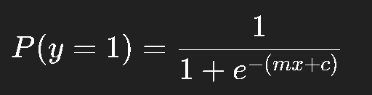
👉 Logistic Regression contd…
Logistic regression is not for predicting prices (continuous values). It’s for predicting categories (e.g. "Expensive" vs "Affordable").
So instead of predicting exact house price, we’ll classify houses into categories (like High Price vs Low Price).
predicts probabilities for categories (e.g., "House has 80% chance of being expensive").
Uses the sigmoid function to squash predictions between 0 and 1:
If probability ≥ 0.5 → classify as 1 (Expensive)
If probability < 0.5 → classify as 0 (Affordable)

Slide 85
🏠 Example: Classify Houses as Affordable vs Expensive
import pandas as pd
from sklearn.linear_model import LogisticRegression
import matplotlib.pyplot as plt
# Example dataset
data = pd.DataFrame({
'Size': [500, 600, 700, 800, 900], # sqft
'Price': [150, 180, 200, 230, 260] # in thousands
})
# Create classification target (Affordable=0, Expensive=1)
# .astype(int): Converts False → 0, True → 1.
data['Expensive'] = (data['Price'] >= 210).astype(int)
X = data[['Size']] # Feature (house size)
y = data['Expensive'] # Target (0 or 1)
# Train logistic regression model
model = LogisticRegression()
model.fit(X, y)

Slide 86
# Predict probability for new house
new_data = pd.DataFrame({'Size': [750]})
# predict_proba(new_data) → returns probabilities for all classes in a 2D array.
probability = model.predict_proba(new_data)[0][1] # Probability of being Expensive
# [0][0] # probability of class 0 (Affordable)
prediction = model.predict(new_data)[0]
print(f"Probability of Expensive: {probability:.2f}")
print(f"Predicted Class: {'Expensive' if prediction==1 else 'Affordable'}")
# Plot decision boundary
sizes = pd.DataFrame({'Size': range(500, 901)})
# only the probability of being Expensive (class=1) for every house size.
probs = model.predict_proba(sizes)[:,1]
plt.scatter(X, y, color='blue', label="Data Points (0=Affordable, 1=Expensive)")
plt.plot(sizes, probs, color='red', label="Logistic Curve")
plt.scatter(new_data, prediction, color='green', label="Data Points (0=Affordable, 1=Expensive)")
plt.xlabel("House Size (sqft)")
plt.ylabel("Probability of Expensive")
plt.legend()
plt.show()

Slide 87
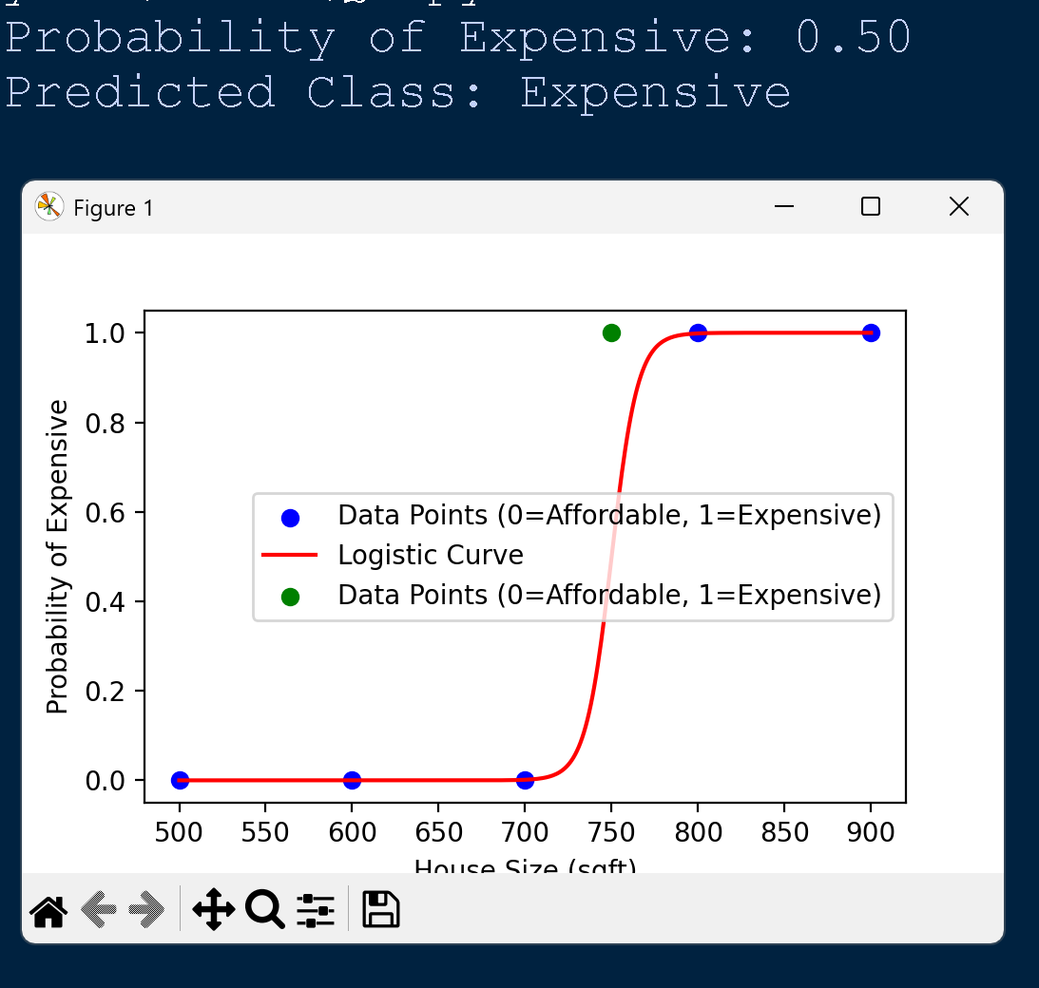

Slide 88
Evaluate Model Performance
✅ This demonstrates how OLS + evaluation metrics together tell us:
The equation of the regression line
The strength of relationship
The accuracy of predictions

Slide 89
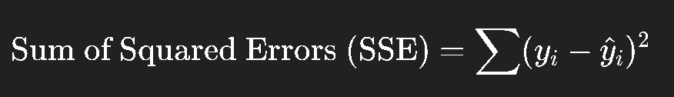
Ordinary Least Squares Estimation
OLS is the method used to find the “best fit line” in linear regression.
“Best fit” means the line where the total squared errors between actual data and predicted values is as small as possible.

Slide 90
import numpy as np
import pandas as pd
from sklearn.linear_model import LinearRegression
# Data
data = pd.DataFrame({
'Size': [500, 600, 700, 800, 900],
'Price': [150, 180, 200, 230, 260]
})
X = data[['Size']]
y = data['Price']
# Train using OLS (scikit-learn uses OLS under the hood)
model = LinearRegression()
model.fit(X, y)
# Predictions
y_pred = model.predict(X)
# Calculate SSE manually
sse = np.sum((y - y_pred)**2)
print(f"Line Equation: Price = {model.coef_[0]:.2f}*Size + {model.intercept_:.2f}")
print(f"Sum of Squared Errors (SSE): {sse:.2f}")

Slide 91
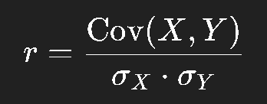
Correlations
Correlation tells us how strongly two variables move together.
Range: -1 to +1
+1 → Perfect positive correlation (as X ↑, Y ↑)
-1 → Perfect negative correlation (as X ↑, Y ↓)
0 → No linear relationship
Formula (Pearson correlation):
Where:
Cov = covariance (joint variability of X and Y)
σ = standard deviation
🏠 Example: House Size vs Price
Bigger houses usually have higher prices.
So correlation between Size and Price will be close to +1.

Slide 92
# Correlation between Size and Price
correlation = data['Size'].corr(data['Price'])
print(f"Correlation: {correlation:.2f}")

Slide 93
Concept | Meaning (Plain English) | Formula (simple form) | Range / Interpretation | Example (House Price Prediction)
Ordinary Least Squares (OLS) Estimation | Method to find the best fit line by minimizing the sum of squared errors between actual and predicted values. | Minimize: ∑(y−y^)² | Always ≥ 0 (smaller = better fit) | Finds line: Price = 0.27*Size + 15
Correlation (r) | Measures strength & direction of linear relationship between two variables. | r=Cov(X,Y) / σX⋅σY | -1 ≤ r ≤ +1 +1 = perfect positive -1 = perfect negative 0 = no relation | Size vs Price → r ≈ 0.99 (very strong positive)
Mean Absolute Error (MAE) | Average of absolute differences between actual and predicted values. | MAE=1/n*∑∣y−y^​∣​ | MAE=1/n*∑∣y−y^​∣ | MAE=1/n*∑∣y−y^​∣
Mean Squared Error (MSE) | Average of squared differences between actual and predicted values. Squaring penalizes big errors more. | MSE=∑(y−y^)²/ n | ≥ 0 (lower = better) | Errors [10, -20, 30] → MSE = (100+400+900)/3 = 467
Root Mean Squared Error (RMSE) | Square root of MSE. Same units as target variable. | RMSE= sqrt{MSE} | ≥ 0 (lower = better) | MSE=467 → RMSE ≈ 21.6
R-squared (R²) | Proportion of variance in target explained by the model. Measures “goodness of fit.” | R²=1−SS_{res}/SS_{tot} | 0 ≤ R² ≤ 1 Higher = better (can be negative if model is very poor) | R² = 0.95 → 95% of house price variation explained by Size

Slide 94
import pandas as pd
import numpy as np
from sklearn.linear_model import LinearRegression
from sklearn.metrics import mean_absolute_error, mean_squared_error, r2_score
# Dataset: House Size vs Price
data = pd.DataFrame({
'Size': [500, 600, 700, 800, 900],
'Price': [150, 180, 200, 230, 260]
})
# Split into input (X) and output (y)
X = data[['Size']]
y = data['Price']
# Train Linear Regression (OLS under the hood)
model = LinearRegression()
model.fit(X, y)
# Predictions
y_pred = model.predict(X)
# --- Metrics ---
# 1. OLS Coefficients
slope = model.coef_[0]
intercept = model.intercept_
# 2. Correlation
correlation = data['Size'].corr(data['Price'])
# 3. Mean Absolute Error
mae = mean_absolute_error(y, y_pred)
# 4. Mean Squared Error
mse = mean_squared_error(y, y_pred)
# 5. Root Mean Squared Error
rmse = np.sqrt(mse)
# 6. R² Score
r2 = r2_score(y, y_pred)
# Print Results
print("OLS Regression Line: Price = {:.3f}*Size + {:.3f}".format(slope, intercept))
print(f"Correlation (r): {correlation:.3f}")
print(f"Mean Absolute Error (MAE): {mae:.3f}")
print(f"Mean Squared Error (MSE): {mse:.3f}")
print(f"Root Mean Squared Error (RMSE): {rmse:.3f}")
print(f"R-squared (R²): {r2:.3f}")

